Slide 1
Pi Pico OOP Mini Project
Ben Jones
Tempe High School
Lecture 1

Slide 2
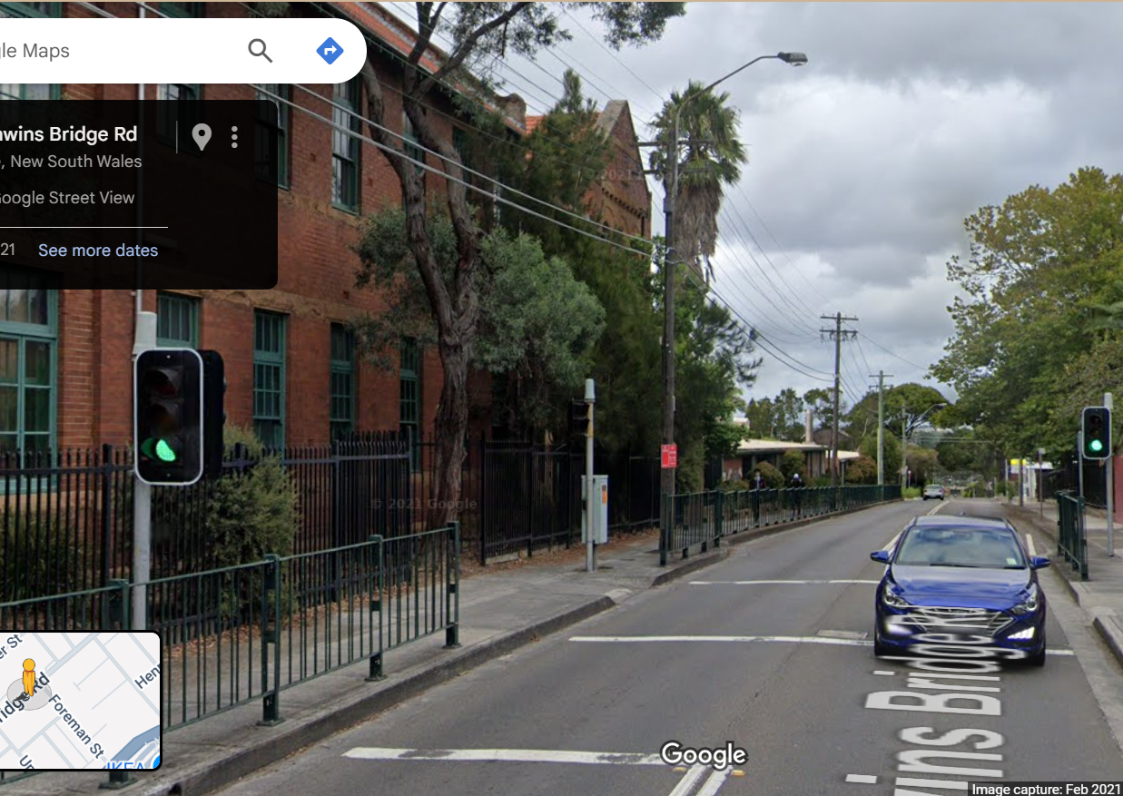
Simple Open Loop Control System
Traffic Lights remain green until pressed (idle state).
Button pressed triggers state change.
Lights rotate through a pattern based on time.
System returns to idle state

Slide 3
Today
Unit Testing
UML (Unified Modelling Language)
Generalisation
Parent/Child Class
Pin & PWM Parent Classes
Instantiation
Inheritance

Slide 4
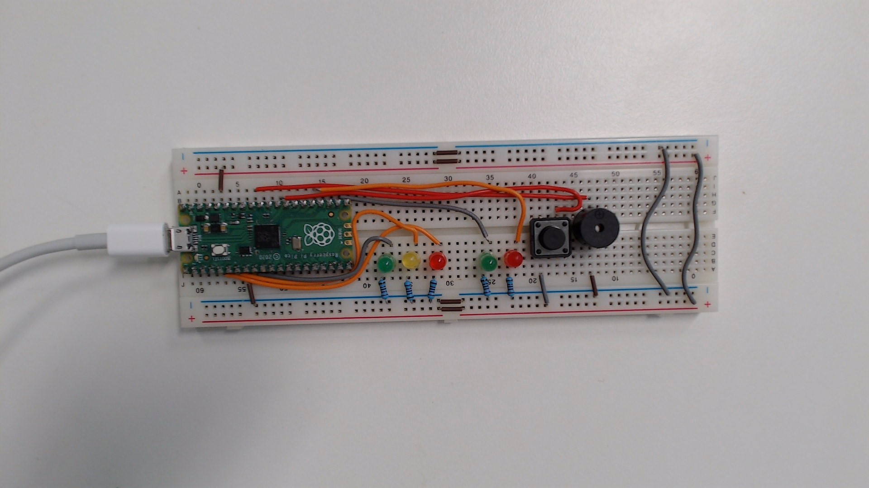
Unit Testing
Testing method where individual components are tested in isolation to verify their correctness.
By ensuring each component works independently, you can build more complex mechatronic solutions.
Logic
Functions
Classes
Components
Controller
Wires
Wiring

Slide 5
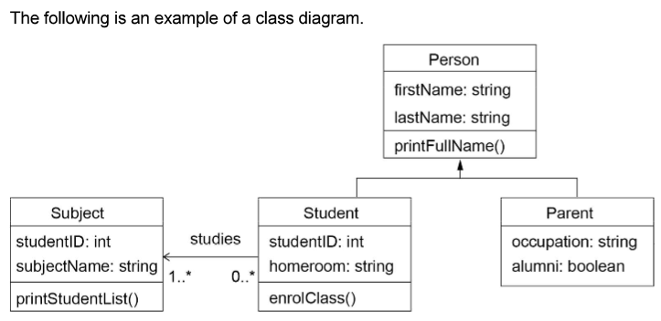
UML
Class Name (Top Section): This is the uppermost part of the box. It displays the name of the class (e.g., Student, Order, Car).
Attributes (Middle Section): This section lists the attributes (or properties/fields) of the class. Each attribute is typically shown with its visibility (+ for public, - for private, # for protected), name, and type.
Methods (Bottom Section): This section lists the methods (or operations/functions) that belong to the class. Each method is shown with its visibility, name, parameters, and return type.
Connections (lines and arrows): These lines and arrows represent relationships (such as inheritance, association, aggregation, and composition) between class boxes.

Slide 6
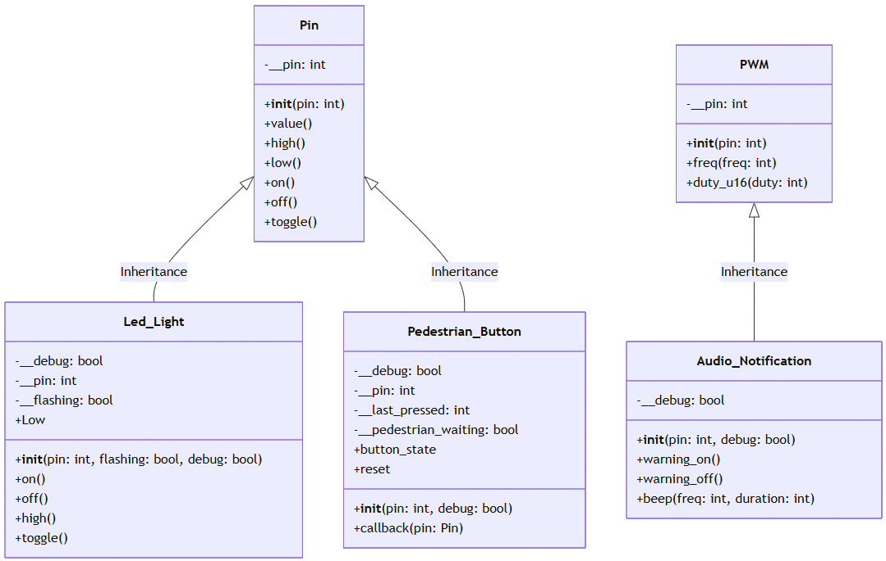
Generalisation
The process of identifying patterns or commonalities among specific examples or cases and formulating a broad class that can be applied to all instances.
On the Pi Pico, the Pin and PWM libraries are designed generalised providing a flexible and reusable interfaces for interacting with the microcontroller’s hardware. The simple on(), off() or high(), low() methods are not specific to any hardware but are generalised to the nature of a digital GPIO Pin.

Slide 7
Parent/Child Class
The parent class defines common attributes and methods that can be shared by its child classes, promoting code reuse and organisation.
The child/subclass inherits (a concept we will next cover) the generalised parent/super class and extends it, providing more specific functionality.
In MicroPython parent classes Pin & PWM are more the most generalised classes which define common attributes and methods that will be used by the less generalised child/sub classes that we will implement.

Slide 8
Bottom Up Development
A common development pattern in OOP, the ‘Bottom up’ approach which involves developing the parent (generalised) classes first. Then, developing the more specific child classes. When you are looking at UML diagrams, the bottom is actually the top of the diagram, with ‘up’ referring to the bottom, which are more specific classes at the bottom of the UML Diagram.

Slide 9
Parent Class Documentation
Machine.Pin Library Documentation
Machine.PWM Library Documentation
The Pin library in MicroPython for the Pi Pico allows you to control the General Purpose Input/Output (GPIO) pins of the Pico. It allows you to configure pins as digital (binary) inputs or outputs.
The PWM Library provides an interface for controlling PWM signals on a specified GPIO pin. It allows you to configure any GPIO pin as a PWM and set the duty cycle and frequency.

Slide 10
Create a v03.py in project\py_scripts\
We will use this py_script to demonstrate some core OOP principles and then develop our first more specific child class for a led light in our traffic light controller.

Slide 11
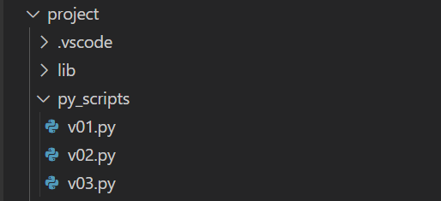
Create a v03.py in project\py_scripts\
We will use this py_script to demonstrate some core OOP principles and then develop our first more specific child class for a led light in our traffic light controller.

Slide 12
Instantiation
Instantiation is a fundamental concept in object-oriented programming (OOP). A class is like a blueprint for an object, it defines the attributes and methods the object will have, but it isn’t an actual object itself.
Instantiation is the process of using the class to create a real, usable object in memory.

Slide 13
Instantiation
from machine import Pin
from time import sleep
led_car_red = Pin(3, Pin.OUT)
led_car_orange = Pin(5, Pin.OUT)
led_car_green = Pin(6, Pin.OUT)
while True:
led_car_red.toggle()
led_car_orange.toggle()
led_car_green.toggle()
sleep(1)

Slide 14
Inheritance
Inheritance is a fundamental concept in object-oriented programming (OOP). It allows a class (called a child or subclass) to inherit properties and behaviours (methods and attributes) from another class (called a parent or superclass).
In this case, the Led_Light class inherits the Pin class, and without any further instructions, the subclass inherits and can call all the methods of the super class, including on(), off(), high(), low(), toggle(), etc.

Slide 15
Inheritance
from machine import Pin
from time import sleep
class Led_Light(Pin):
# child class inherits the parent 'Pin' class
def __init__(self, pin):
super().__init__(pin, Pin.OUT)
red_light = Led_Light(3)
while True:
red_light.toggle()
sleep(1)

